Slide 1
Lending Club Case Study
Exploratory Data analysis
By Tamal Saha & Dharmendra Singh Chouhan

Slide 2
Executive Summary
Data Background
The data contains information about past loan applicants and whether they ‘defaulted’ or not.
The dataset contains information starting from 2007 to 2011
Objective
The aim is to identify patterns which indicate if a person is likely to default, which may be used for taking actions such as denying the loan, reducing the amount of loan, lending (to risky applicants) at a higher interest rate, etc.
Analysis
Data Cleaning – Removing Columns with 100% null values, presence of extreme values, reclassifying existing column types
Univariate, Bi-variate analysis
Key Observations
~14% Charge-off accounts
Top 5 states (CA, FL, NY, TX and NJ) account for ~48% of the charge-off accounts
Income, Grade are key driving factors to identify charge-off accounts
2

Slide 3
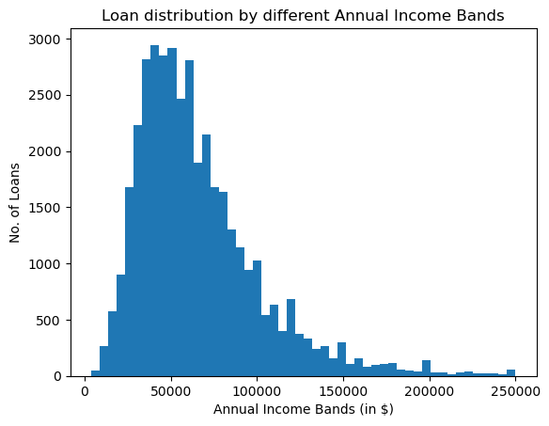
~95% of the loans are provided to the customers with annual income less than $150k
3

Slide 4
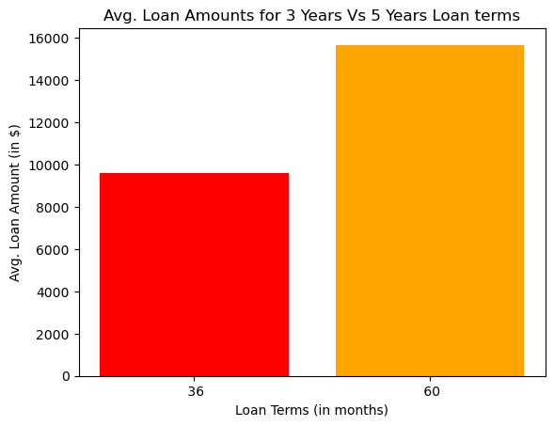
Overall Avg loan size is ~$11.2k. Avg Loan amounts are ~60% higher for 5 years than 3 years tenure
15,600
9,500
4

Slide 5
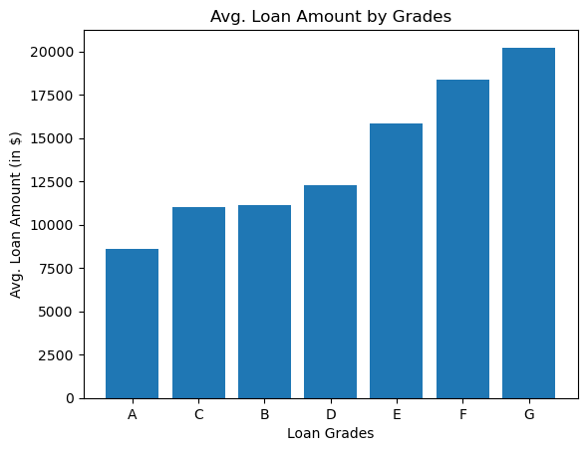
Avg Loan amounts increase from loan grade ‘A’ to ‘G’
20,200
18,300
15,800
12,300
11,000
11,000
8,600
5

Slide 6
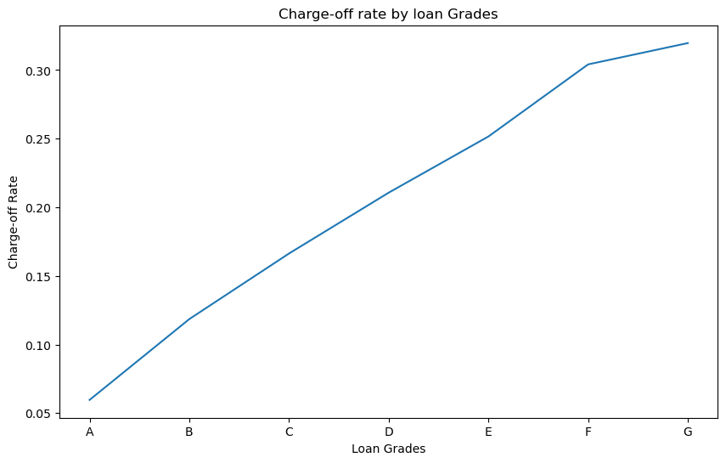
Increasing Charge-off rates from grade A to G shows the increasing risk and loan quality deterioration
6

Slide 7
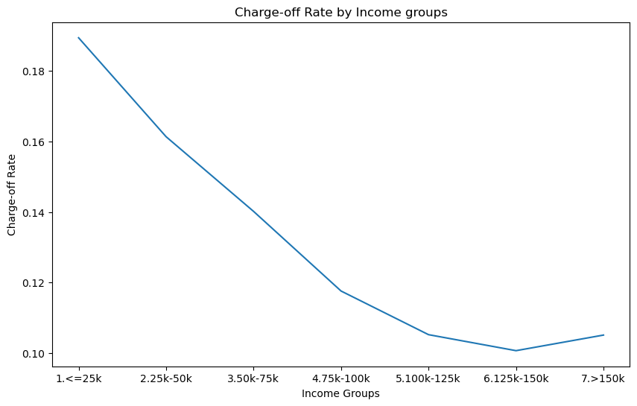
Customers with higher annual income has less chance of getting charged-off
7

Slide 8
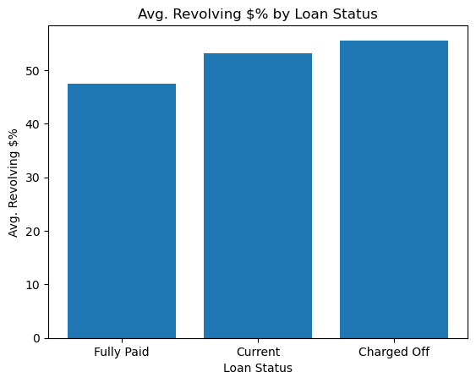
Charge-off accounts have higher revolving dollar percentage than other accounts
55.6%
53.2%
47.5%
8

